Slide 1
Microsoft R Server Overview
Slalom Consulting
Instructors & proctors:
Dan Tetrick, Ben Ahlvin, Janet Guerrero

Slide 2
Day One Modules
The Microsoft R Data Stack
The Core Principles of R
Functional Programming in R
Deep-dive into the dplyr package for data manipulation
The dplyrXdf Package: using dplyr syntax with xdf
Day Two Modules
Modeling and Scoring with Microsoft R Server
Parallel Computing
Azure Portal: provisioning a Data Science Virtual Machine
HDInsights Insights
SQL Server and R Services

Slide 3
Quick Poll
(1) What is your level of R experience?
Low/Medium/High
(2) What do you hope to get out of the class?
Notes:
Use this place holder to take the temperature of the class

Slide 4

What is
Language
Platform
A statistics programming language
Single-threaded
Data stored in memory
A data visualization tool
Open source
Focus on statistics and machine learning
Community
2.5+M users
Taught in most universities
New and recent grad’s use it
Thriving user groups worldwide
Ecosystem
10,000+ free algorithms in CRAN
Scalable to big data
Rich application & platform integration
Notes:
Slide objective
Establish that R is a language is as important for the community that uses it an the capabilities written to extend it than the language itself.
Talking points
Part 1 of the R World is The R language, developed specifically for data analysis – particularly among statisticians and mathematicians.
[optional points]:
Developed in New Zealand, release in roughly 2000.
Maintained by the R Foundation which releases new editions of R every few weeks.
Licensed under GPL open source license.
R directly supports complex data manipulation operations making them extremely simple for users, particularly those with greater depth in statistics and mathematics than in computer science.
Huge community of users across industry, government and academia use R daily.
There are R user groups in most major cities. Some of them very active and very large. Suggest that users look at MeetUp for local groups that meet regularly.
Most important to the value of R is the huge repository of freely exchanged, algorithms, techniques, scripts, adapters, techniques, training available.
Introduce CRAN: “The Comprehensive R Archive Network”.
Data access & integration
Data transformation
Data profiling
Data visualization
Predictive analytics
Machine Learning
CRAN contains over 7000 (and growing) contributed packages. Many algorithms, test data, comments on usage, etc. One package contains hundreds of algorithms packaged as a library.
All are designed to run with the R language.
CRAN is the largest but not the only. Thousands of additional algorithms, visualizations and tools are available from BioConductor, GitHub and other repositories.
Notes

Slide 5
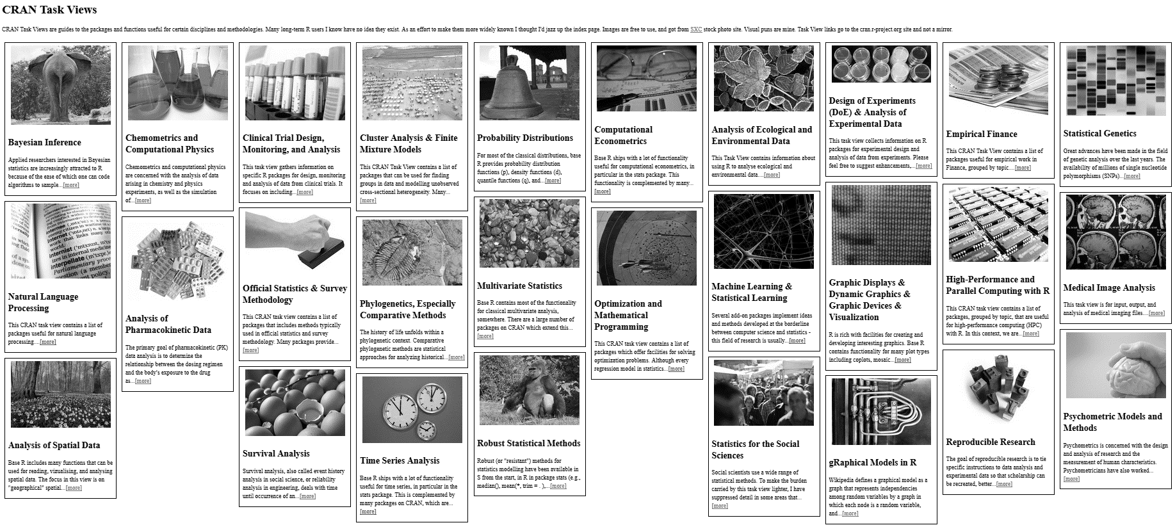
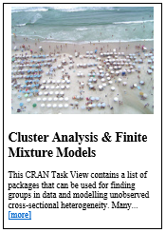
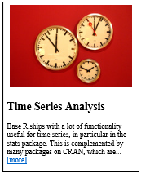
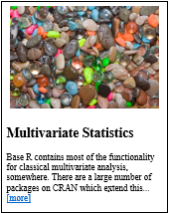

CRAN: Comprehensive R Archive Network
In addition to CRAN, Bioconductor, GitHub, others distribute R packages
Notes:
CRAN Task View by Barry Rowlingson: http://www.maths.lancs.ac.uk/~rowlings/R/TaskViews/

Slide 6
Challenges posed by open source R
?
?
Limited Data Scale
Inadequate
Modeling Performance
Lack of Commercial Support
Complex Deployment
Processes
Notes:
Slide objective
Introduce how the use of open source R for machine learning and advanced analytics has been limited to a narrow user base of data scientists. Related to this, also discuss how many challenges and complexities remain for advanced analytics in the marketplace.
Talking points
Today, advanced analytics using open source R are being performed only by highly trained and specialized data scientists, mathematicians, and analysts who can create and nurture these models. This means that many challenges and complexities remain in the marketplace.
First, many companies cannot negotiate the increasing costs of specialized talent, infrastructure, and machine learning tools that make total cost of ownership (TCO) and return on investment (ROI) uncertain.
Second, siloed and cumbersome data management restricts access to data and poses limitations on what data can be included in models.
Third, trying to collaborate across complex and fragmented technologies tends to limit agility and reduce participation in exploring data and building models. People end up struggling with the technology instead of focusing on the business problem at hand.
Finally, many models never achieve business value because it’s so difficult to deploy them to stable production environments. If you can imagine spending hundreds of thousands of dollars on a solution and having it never go into production, you can see why machine learning has been so niche up to this point.
Notes

Slide 7
Microsoft R Server
MRS extends open-source R to allow:
Multi-threading
Matrix operations, linear algebra, and many other math operations run on all available cores
Parallel processing
ScaleR functions utilize all available resources, local or distributed
On-disk data storage
RAM limitations lifted – Break Through Your Memory Barrier!

Slide 8
R from Microsoft brings
Peace of mind
Efficiency
Speed and scalability
Flexibility and agility
Notes:
Slide objective
At a high level, describe the evolution of predictive analytics technology and its current state in the marketplace. Also, introduce the related value proposition of combining the R programming language with the Microsoft data platform.
Talking points
Data is the currency of modern business; from the cloud to on-premises and everything in between, access to data anytime, anywhere from varied sources has become a requirement for successful planning and operation. Today, the R open source programming language enables organizations to move beyond reacting to data after the fact, and begin predicting results and gathering proactive insights to help plan ahead.
Basically, an evolution is taking place.
The rise of machine learning and advanced analytics gives us the ability not only to look at historical data to understand what happened and why, but also to harness predictive analytics to peer into the future. With predictive analytics, we can better understand what is likely to happen and identify what actions should be taken so businesses can automate outcomes.
Again, to date, R has been available only as open source. But now that’s changed, and Microsoft is introducing a new value proposition.
With R from Microsoft, you get:
peace of mind,
Efficiency,
Speed and scalability,
And flexibility and agility.
Notes

Slide 9
Microsoft R Server family
From Data To Action On Premises
Data Sources
People
Cortana Intelligence
+
Apps
Apps
Sensors and devices
Automated Systems
Microsoft R Server & SQL R Services
DATA
INTELLIGENCE
ACTION
Notes:
Slide Objective
Introduce the two product families and transition to high-level product overviews.
Talking Points
Microsoft brings two complementary product lines to bear on the challenges of Advanced Analytics.
Cortana Intelligence Suite provides a rich, end-to-end, cloud-based advanced analytics capability.
Microsoft’s R Server and SQL R Services products leverage a predominantly on-premises point of view – designed for users with significant investments in on-premises data, data repositories, and application portfolios.
Notes
Avoid being dragged into a direct comparison of the two products. There is not a clear answer until much more is known about the audience and their challenges.
If you get dragged into this discussion you may well lose the remainder of your time.

Slide 10
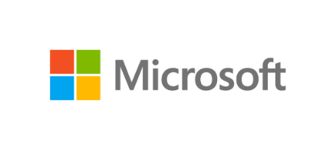
Microsoft R portfolio
Microsoft R portfolio
Community
Commercial
SQL Server
R Services
R Open
R Server
Windows
Linux
Hadoop
Teradata
Spark
Notes:
Slide objective
Show broad commitment to R by preserving freely available, enhanced editions, Windows and SQL Server editions and R Server editions for leading EDWs, Linux and Hadoop platforms.
Differentiate free, open editions from commercial by mentioning availability of commercial 24x7 support, and enhancements to support very large scale data analytics at speed.
Talking points
Notes

Slide 11
Introducing Microsoft R Server
Linux, Windows, Hadoop & Teradata
High-performance, Scalable R
100% open source R
CRAN, Bioconductor, MRAN, GitHub compatibility
Big-data connectivity
Scalable analytics
Multi-platform
In-database, in-cluster scalability
Choice of IDE
R Server Technology
CRAN
Microsoft R Open
Remote Execution
Machine Learning
PEMA / ScaleR
HDInsight/SQL Integration
Open Source Components
Licensed Capabilities
Notes:
Microsoft R Server is a broadly deployable enterprise-class analytics platform based on R that is supported, scalable and secure. Supporting a variety of big data statistics, predictive modeling and machine learning capabilities, R Server supports the full range of analytics – exploration, analysis, visualization and modeling
Slide objective
Introduce the high –level value of R Server and R Services over other instantiations of the R language.
Talking points
R Server products provide an enhanced experience for the R User without loss of compatibility
R Server products are “open core” – the utilize the open source R product entirely and build new capabilities around that core without impacting compatibility.
Users of R Server products enjoy full compatibility with open source compatible with the entire (and vast) collection of algorithms, connectors, visualization tools shared openly via CRAN, Bioconductor and other shared resources like GitHub.
Key extensions enable R to tackle big data challenges that exceed the capacity of open source R.
R Scripts built for one platform using R Server can be easily run on another platform running R Server
We call it WODA – write once, deploy anywhere.
Two key contributions:
Build on any version of the product and deploy using other versions
Investment protection as platform choices change
Develop on the desktop and immediately deploy to RDBMS – SQL Server, EDW (SQL Server & Teradsata) or Hadoop (Microsoft, Cloudera, Hortonworks and MapR)
Notes

Slide 12
Portability & investment assurance
Windows
Linux
HDInsight
Cloud
Hortonworks
Cloudera
MapR
Hadoop & Spark
R Server Technology
R Server portfolio
EDW
SQL Server 2016
Teradata Database
CRAN
Microsoft R Open
Remote Execution
RDBMS
SQL Server 2016 EE
SQL Server 2016 SE
Machine Learning
PEMA / ScaleR
Desktops & Servers
Windows
Linux
HDInsight/SQL R Integration
Write Once – Deploy Anywhere
Notes:
…. In the multi-platform world of on-premises…
Slide objective
Differentiate R Server from other R offerings such as vendor-specific offers from Oracle, HP, SAP and Teradata
Clearly communicate two benefits – develop on multiple machines, and protect investments from platform change disruptions later.
.
Talking points
R Server makes your data scientists’ jobs easier. By running identically on multiple platforms, users can build on one platform, the move the scripts to another. This has several advantages:
Run modeling algortihms on systems here larger compute or data storage is available.
It also permits modesl to be built on one platform, but model scoring or operationalization to take place elsewhere.
Finally, with the availability of very low storage and compute costs in the cloud, users can load, transform, visualize, study and model data in the cloud, but actually run the model computations on on-premises systems.
Perhaps more importantly, however, portability across systems protects organizations investments in R-based data science.
The best best big data storage and compute platform for today may not be the best choice tomorrow.
Compatibility across systems brings the possibility to avoid disruptive recoding efforts when such changes occur.
Notes
Two ways to underscore this point are to describe the range of compatibility available with other vendor’s R versions. Oracle R, because it works only with algorithms running on Oracle Database, is not portable. The same is true for R implementations from Teradata, HP Vertica, SAP and others. They are in essence platform specific.
Another way to describe the problem is with a fictitious story: Imagine a CIO who has to tell his data science team “we’re changing platfomrs, and therefore, you need to change all your programs and scripts to work with the new platform”.

Slide 13
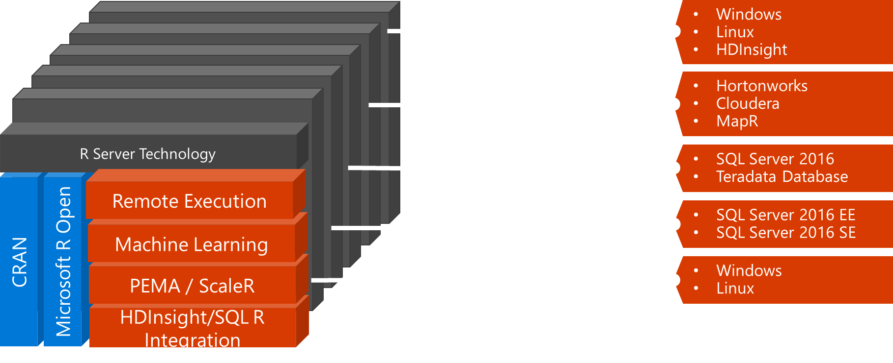
MRS in Different Contexts
On a workstation, that means:
All available cores will be used for math operations and parallel processes
Hard drive capacity sets limit for data size, not RAM
On a cluster:
Parallel utilization of all available nodes
Distributed file systems like HDFS greatly expand possible data sizes

Slide 14
Available Algorithms
Linear regression (rxLinMod)
Generalized linear models (rxLogit, rxGLM)
Decision trees (rxDTree)
Gradient boosted decision trees (rxBTree)
Decision forests (rxDForest)
K-means (rxKmeans)
Naïve Bayes (rxNaiveBayes)
Note: models available in open-source R packages won’t be made parallel automatically

Slide 15


Parallelized, Remote Execution Algorithms
Data Step
Data import – Delimited, Fixed, SAS, SPSS, OBDC
Variable creation & transformation
Recode variables
Factor variables
Missing value handling
Sort, Merge, Split
Aggregate by category (means, sums)
Statistical Tests
Chi Square Test
Kendall Rank Correlation
Fisher’s Exact Test
Student’s t-Test
Variable Selection
Stepwise Regression
Simulation
Simulation (e.g. Monte Carlo)
Parallel Random Number Generation
Sampling
Subsample (observations & variables)
Random Sampling
Cluster Analysis
K-Means
Descriptive Statistics
Min / Max, Mean, Median (approx.)
Quantiles (approx.)
Standard Deviation
Variance
Correlation
Covariance
Sum of Squares (cross product matrix for set variables)
Pairwise Cross tabs
Risk Ratio & Odds Ratio
Cross-Tabulation of Data (standard tables & long form)
Marginal Summaries of Cross Tabulations
Predictive Models
Sum of Squares (cross product matrix for set variables)
Quantiles (approx.)
Generalized Linear Models (GLM) exponential family distributions: binomial, Gaussian, inverse Gaussian, Poisson, Tweedie. Standard link functions: cauchit, identity, log, logit, probit. User defined distributions & link functions.
Covariance & Correlation Matrices
Logistic Regression
Classification & Regression Trees
Predictions/scoring for models
Residuals for all models
Classification
Decision Trees
Decision Forests
Gradient Boosted Decision Trees
Naïve Bayes
Combination
rxDataStep
rxExec
PEMA-R API Custom Algorithms
Notes:
https://msdn.microsoft.com/en-us/microsoft-r/scaler/scaler

Slide 16
Summary: use MRS when…
Working with data too big to fit into memory
Building models that take too long to run
Working with clusters and distributed file systems

Slide 17
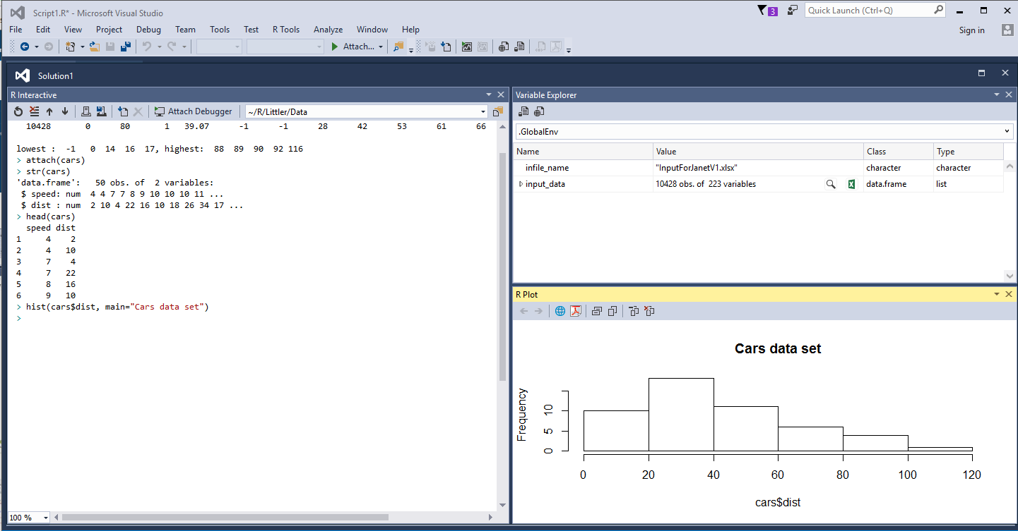
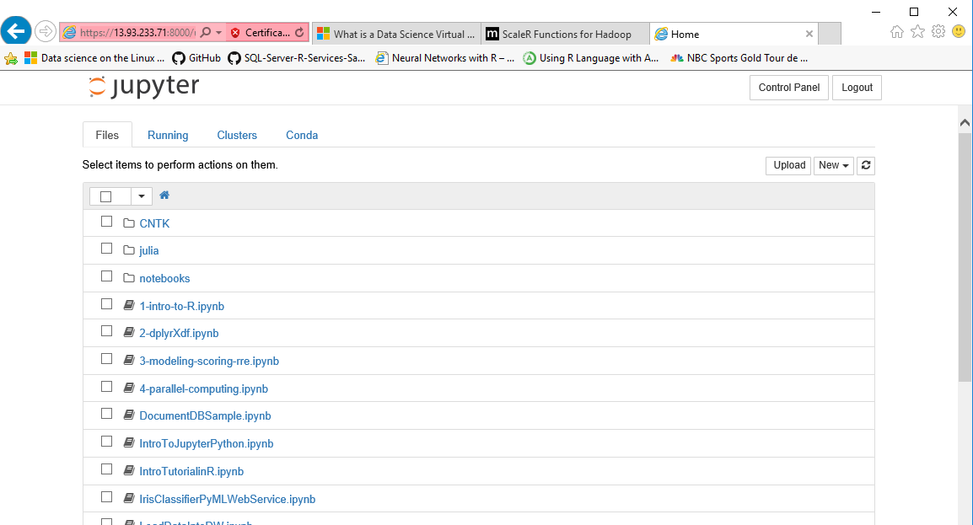
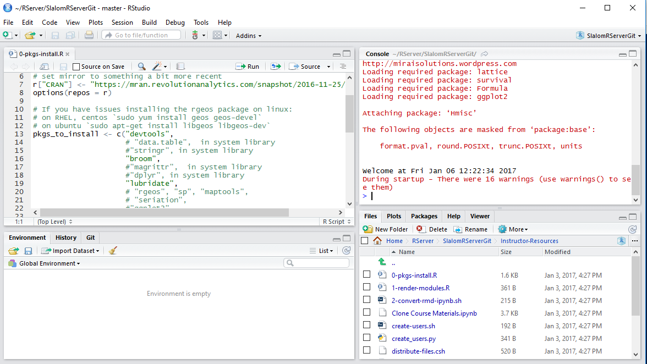
There are several R Clients
Microsoft R Client (VS)
Jupyter Notebooks
R Studio

